Slide 1
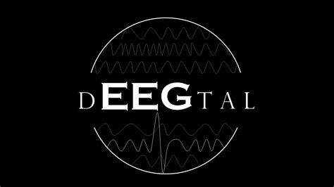
Job interview
Coding Task presentation
Jeroen Buil

Slide 2
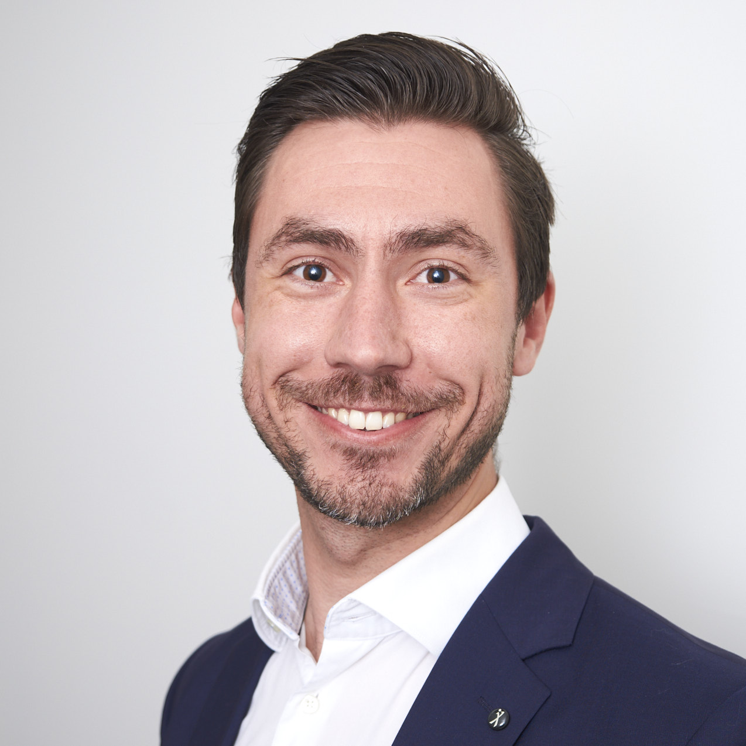
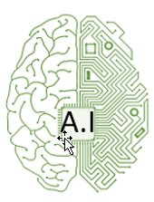










Short introduction
Jeroen Buil
Senior ML Researcher / Project Lead - WFBR
Artificial Intelligence
Data Collection
Models
Insights
2013
Now

Slide 3
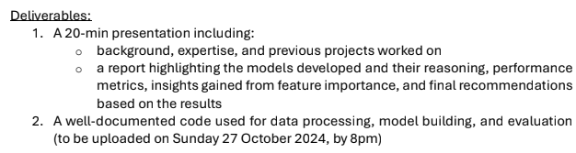
Assignment + Deliverables
Objective: Build models to classify whether an EEG belongs to Group1 or Group2.
Tasks:
Exploratory Data Analysis
Feature Engineering
Build Model
Hyperparameter Tuning
Model Evaluation
Explainability

Slide 4
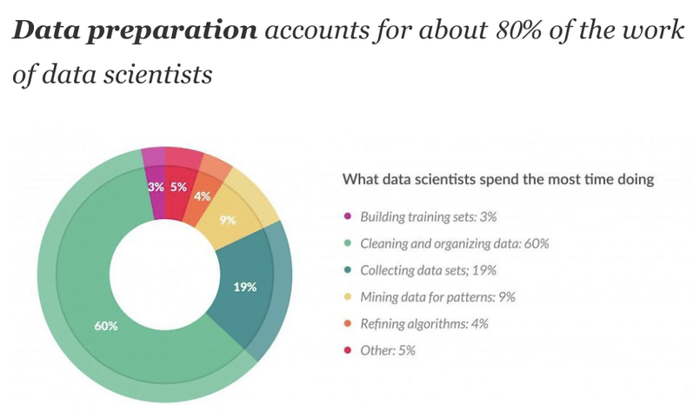

Time allocation – 80/20 rule
Effort spend:
~2.5 days
Aim:
How I work
How I think
Disclaimer:
"Playing the whole game": A data collection and analysis exercise with Google Calendar - Scientific Figure on ResearchGate. Available from: https://www.researchgate.net/figure/The-80-20-rule-of-data-wrangling_fig2_339550606 [accessed 25 Oct 2024]

Slide 5

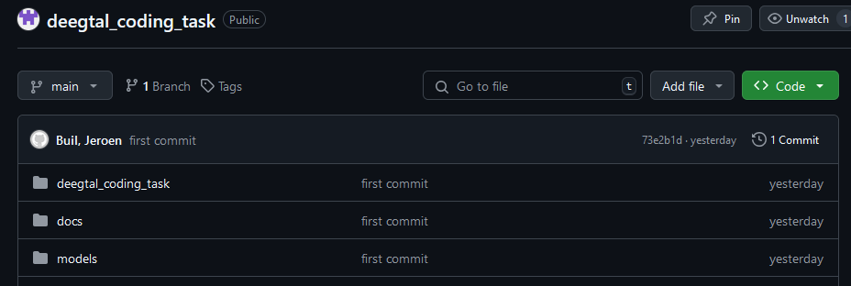
Git Repository
https://github.com/JeroenBuil/deegtal_coding_task
For this project
Stack:
Python
VSC
In reserve
Stack:
MS Azure
Databricks
SQL
Power BI
…
Packages:
MNE
Scikit-Learn
Matplotlib
Captum
DIY

Slide 6
Exploratory Data Analysis

Slide 7
Exploratory Data Analysis
What are we dealing with?
Data quality?
Preprocessing?
Patterns?
Quick Stats:
2 Groups
Unknown conditions
Unknown stimuli
5 recordings each
Recording time: ~15-25min
Fs: 250 Hz
Filtering: 125 Hz lowpass

Slide 8
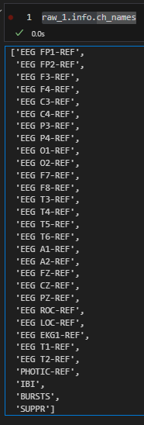
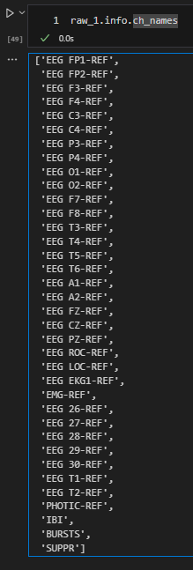
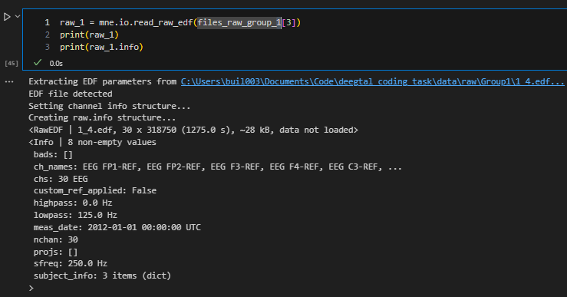
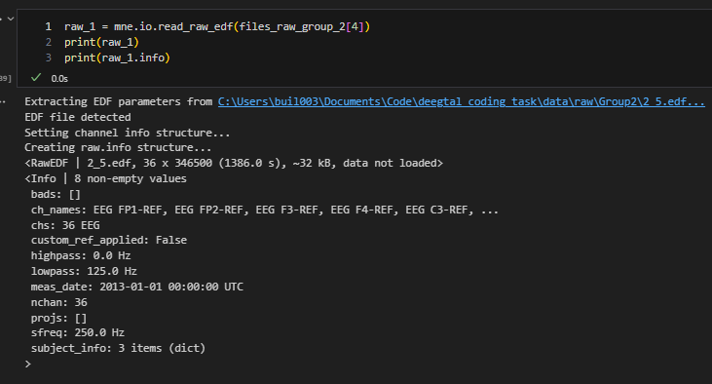
Data Quality - Consistency
Different recording methods (30ch vs 36ch)
Different experimental procedure
photic stim?
IBI (interburst intervals?)
Bursts?

Slide 9
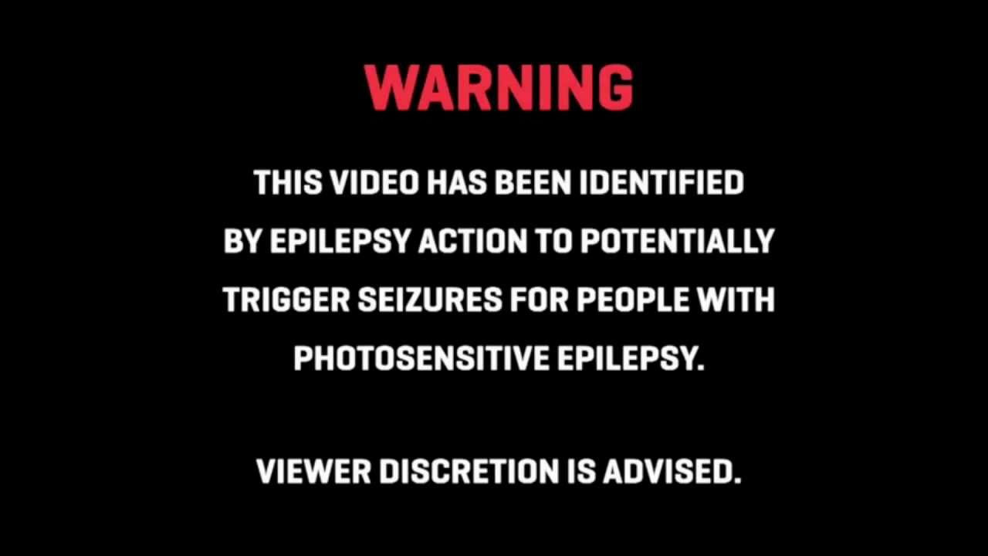
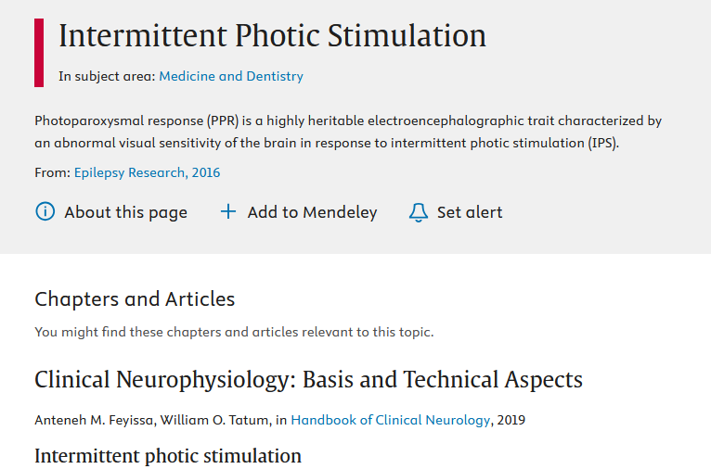
Intermittend Photic Stimulation
Photic Pulse train pulse in some recordings
Unfortunately not all channels
Otherwise could be good epoch

Slide 10
No consistent stim found
Group | Recording | Channel | Mean | Std
1 | 1 | BURSTS | 0.339228 | 0.53042
1 | 2 | BURSTS | 0.0 | 0.0
1 | 3 | BURSTS | 0.0 | 0.0
1 | 4 | BURSTS | 0.392392 | 0.658648
1 | 5 | BURSTS | 0.680574 | 0.528815
2 | 1 | BURSTS | 0.237873 | 0.584785
2 | 2 | BURSTS | 0.0 | 0.0
2 | 3 | BURSTS | 0.0 | 0.0
2 | 4 | BURSTS | 0.0 | 0.0
2 | 5 | BURSTS | 0.0 | 0.0
1 | 1 | IBI | 22.108351 | 3.2969
1 | 2 | IBI | 0.0 | 0.0
1 | 3 | IBI | 0.0 | 0.0
1 | 4 | IBI | 10.253176 | 1.226951
1 | 5 | IBI | 87.96198 | 88.083157
2 | 1 | IBI | 1.674255 | 5.940473
2 | 2 | IBI | 0.0 | 0.0
2 | 3 | IBI | 0.0 | 0.0
2 | 4 | IBI | 0.0 | 0.0
2 | 5 | IBI | 0.0 | 0.0
1 | 1 | PHOTIC-REF | 0.000003 | 0.00006
1 | 2 | PHOTIC-REF | 0.000002 | 0.000046
1 | 3 | PHOTIC-REF | 0.0 | 0.0
1 | 4 | PHOTIC-REF | 0.000004 | 0.000063
1 | 5 | PHOTIC-REF | 0.000004 | 0.000062
2 | 1 | PHOTIC-REF | 0.000003 | 0.000059
2 | 2 | PHOTIC-REF | 0.0 | 0.0
2 | 3 | PHOTIC-REF | 0.0 | 0.0
2 | 4 | PHOTIC-REF | 0.0 | 0.0
2 | 5 | PHOTIC-REF | 0.0 | 0.0
I don’t know what is done!
=> Feature extraction more difficult…
Question:
How comparable are these recordings?

Slide 11
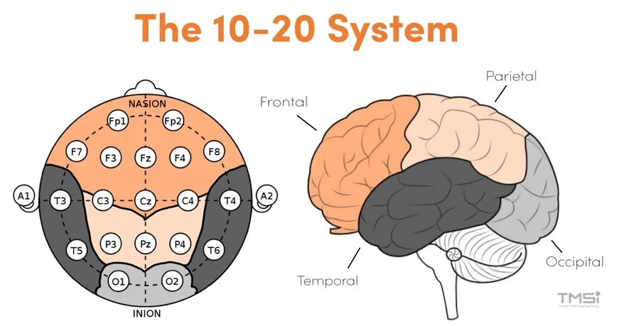
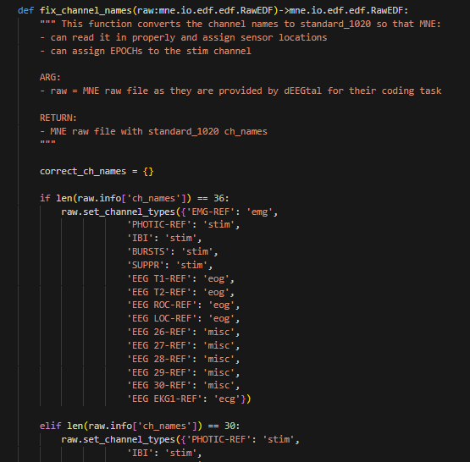
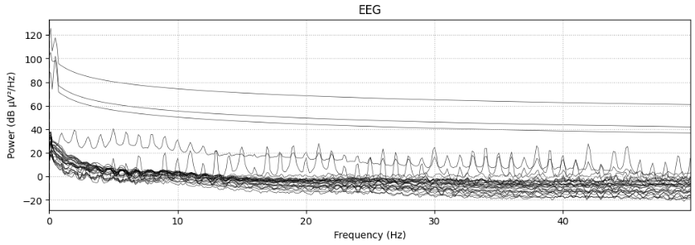
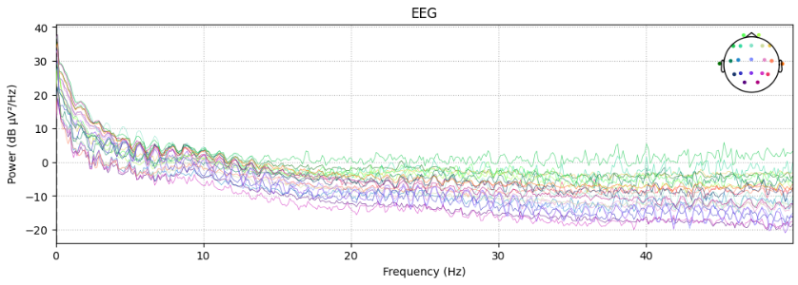
Data Quality – Ch names
Channels not in 10-20 montage naming
=> Fix + set_montage()
=> Simplifies working with MNE
https://info.tmsi.com/blog/the-10-20-system-for-eeg

Slide 12
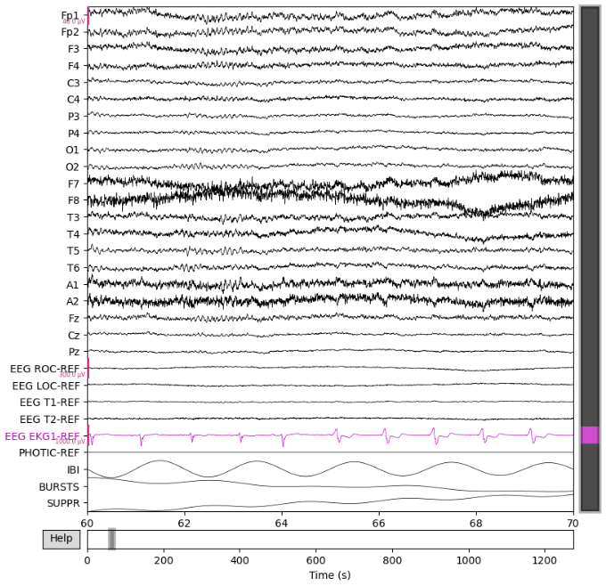
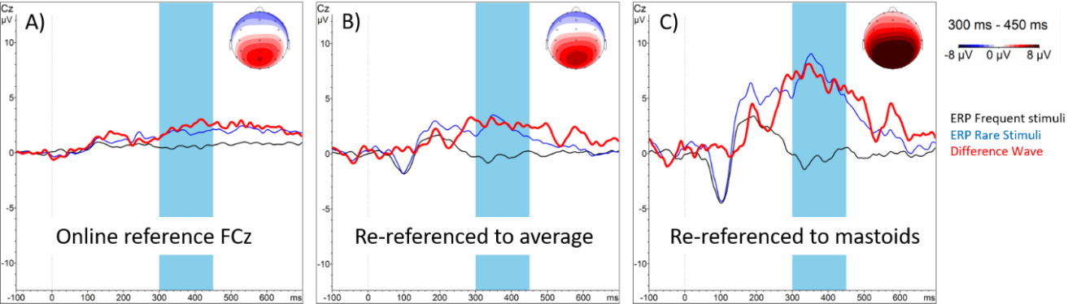
Referenced?
https://pressrelease.brainproducts.com/referencing/

Slide 13
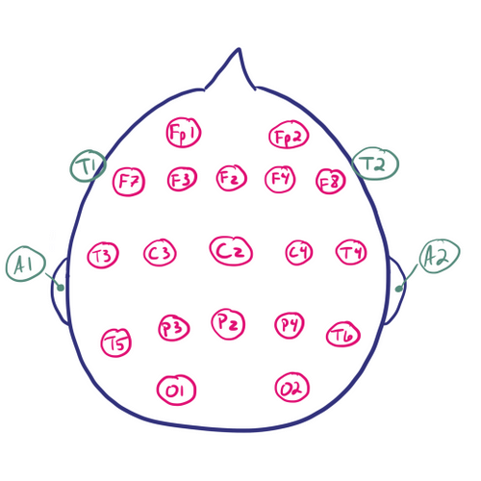
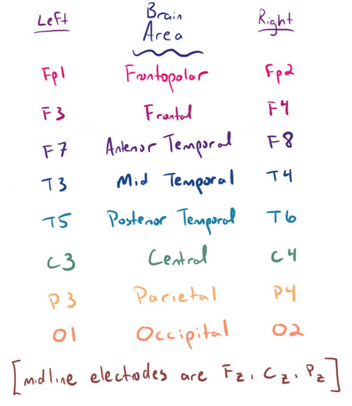
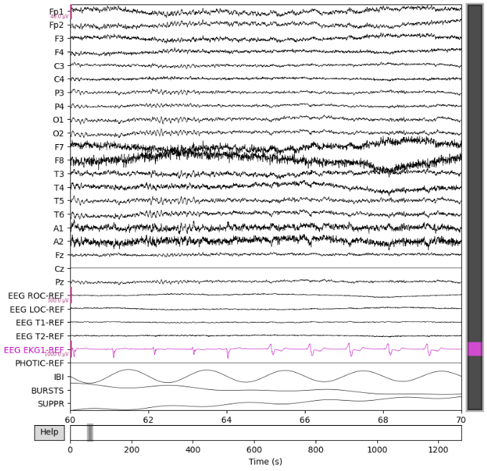
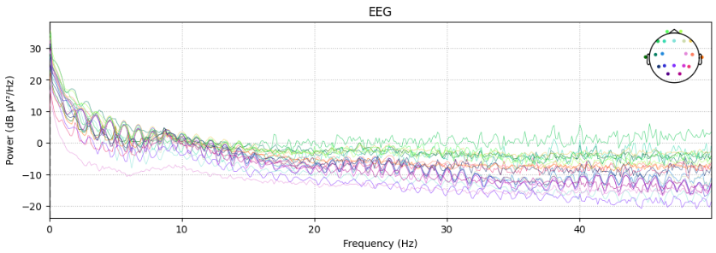
Re-referencing!
https://www.learningeeg.com/montages-and-technical-components

Slide 14
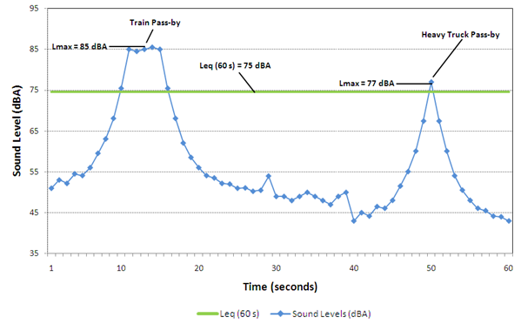
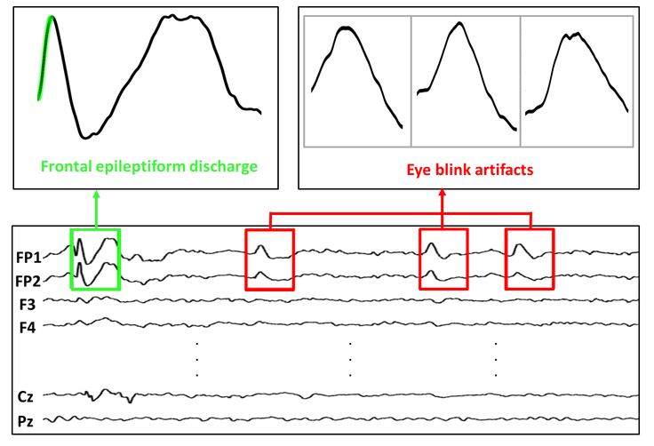
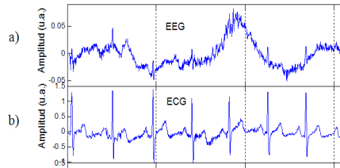
EEG Preprocessing + Artefact Removal
Non-biological/Environment
Biological
Powerline noise, traffic
=> bandpass + bandstop filtering
eye blinking, movement, respiration, and heartbeat
Often same freq range
Solutions: grounding, linear regression
A Survey on Artifacts Detection Techniques for Electro-Encephalography (EEG) Signals - Scientific Figure on ResearchGate. Available from: https://www.researchgate.net/figure/a-EEG-Signals-with-Artifacts-Caused-by-b-ECG-Signals-and-C-EMG-Signals-25_fig3_281887837 [accessed 23 Oct 2024]
https://otc-cta.gc.ca/eng/railway_noise_measurement
Eye Blink Artifact Detection With Novel Optimized Multi-Dimensional Electroencephalogram Features - Scientific Figure on ResearchGate. Available from: https://www.researchgate.net/figure/Frontal-epileptiform-discharges-and-eye-blink-from-CHZU-database_fig1_353475354 [accessed 23 Oct 2024]
https://pmc.ncbi.nlm.nih.gov/articles/PMC861531/

Slide 15
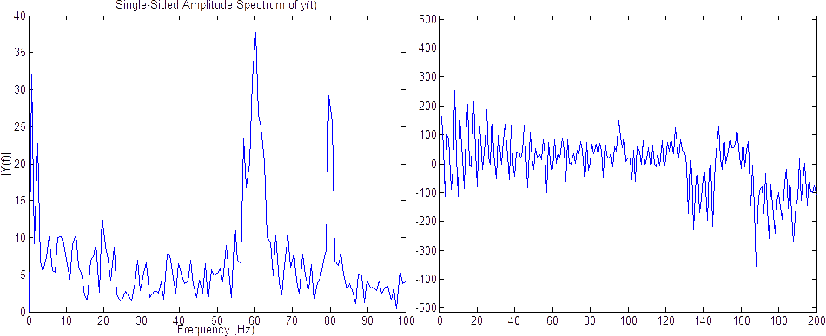
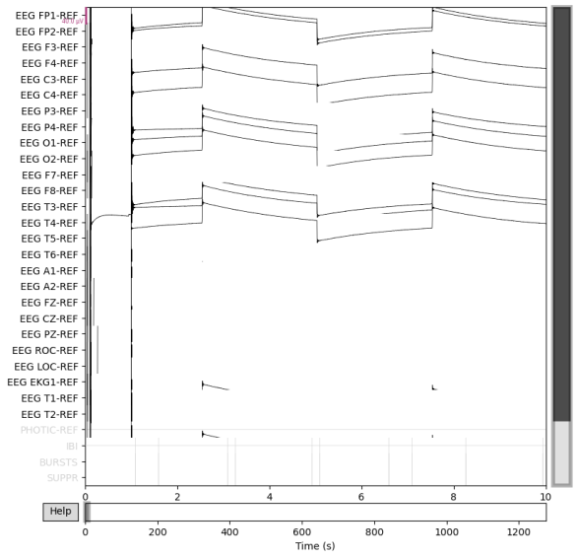

Filtering
Done:
Bandpass: 0,5-100 Hz
Notch: 60 Hz
Crop start + end of recording
Not done (but probably should!)
Remove EOG + ECG artefacts
=> Regression / ICA + (NN) Model
https://people.ece.cornell.edu/land/courses/ece4760/FinalProjects/s2012/cwm55/cwm55_mj294/

Slide 16

EDA - Conclusion
Crucial info is missing:
Where/how/why/by whom is data recorded?
What is separating the groups?
Consequence:
Unnecessary long puzzling
Risk of false comparison/assumptions between groups
https://www.depop.com/products/peypeym-source-unknown-brand-low-rise/
Personal rule:
No Source + Metadata == No (usable) Data

Slide 17
Feature Engineering

Slide 18
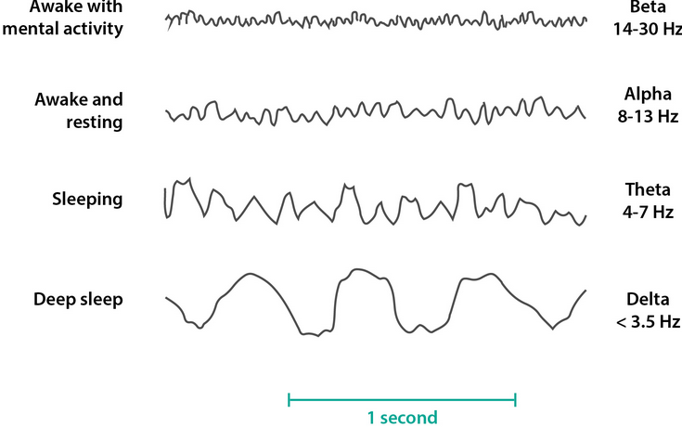
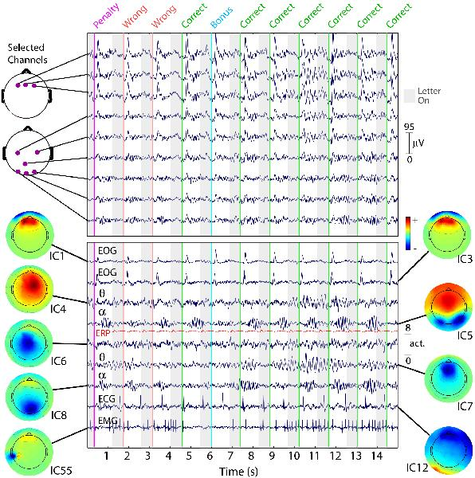
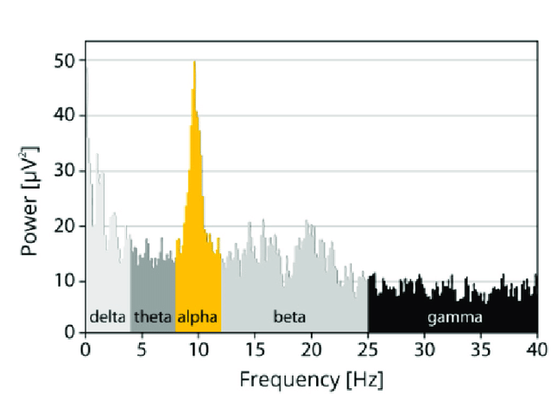
What is feature?
Many options:
Voltage
“raw” signal
Specific frequencies
Power spectrum
Entire recording
Window
Specific brain wave
ICA
…
https://eeglab.org/tutorials/ConceptsGuide/ICA_background.html

Slide 19
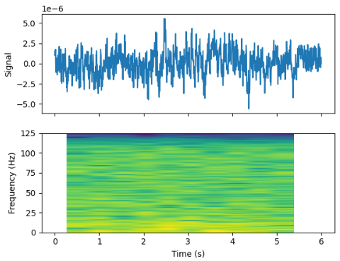
Spectogram (time-freq analysis)
KISS principle:
Filtered EEG
1 channel
Cut into windows
=> many samples!
Time-Frequency plot

Slide 20
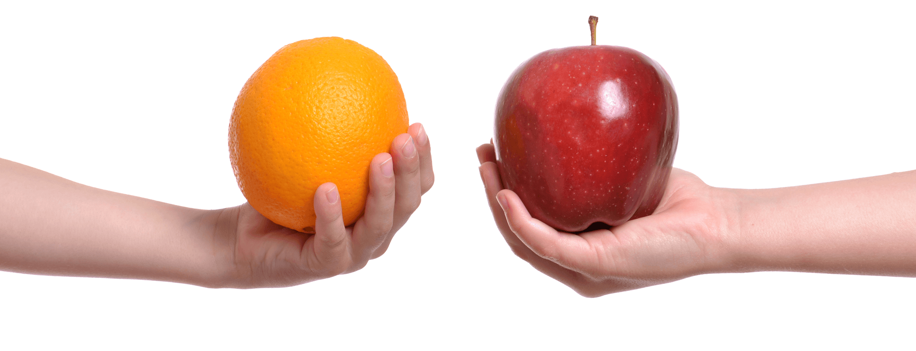
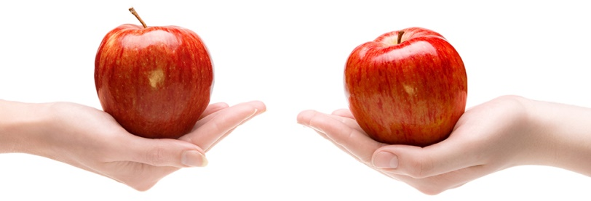
Windowing choices
Assumption:
Same equipment
Same procedure
Same mental state
Same physical state
5minute in the center of the recording:
~70x 10s windows (6 sec overlap)
0.5-100 Hz => Nyquist >= 4 sec window
Spectogram for each window
Ideal situation:
Actual situation:
Cut corners!

Slide 21
Build model Evaluate Explain

Slide 22
ML Models
Supervised
+ use class info to your advantage
- Requires annotation
Unsupervised
+ fast, no pre knowledge, unbiased
- less info to train
CNN
(XGBoost)
Preferred!
PCA
tSNE
Clustering
Quick exploration!

Slide 23
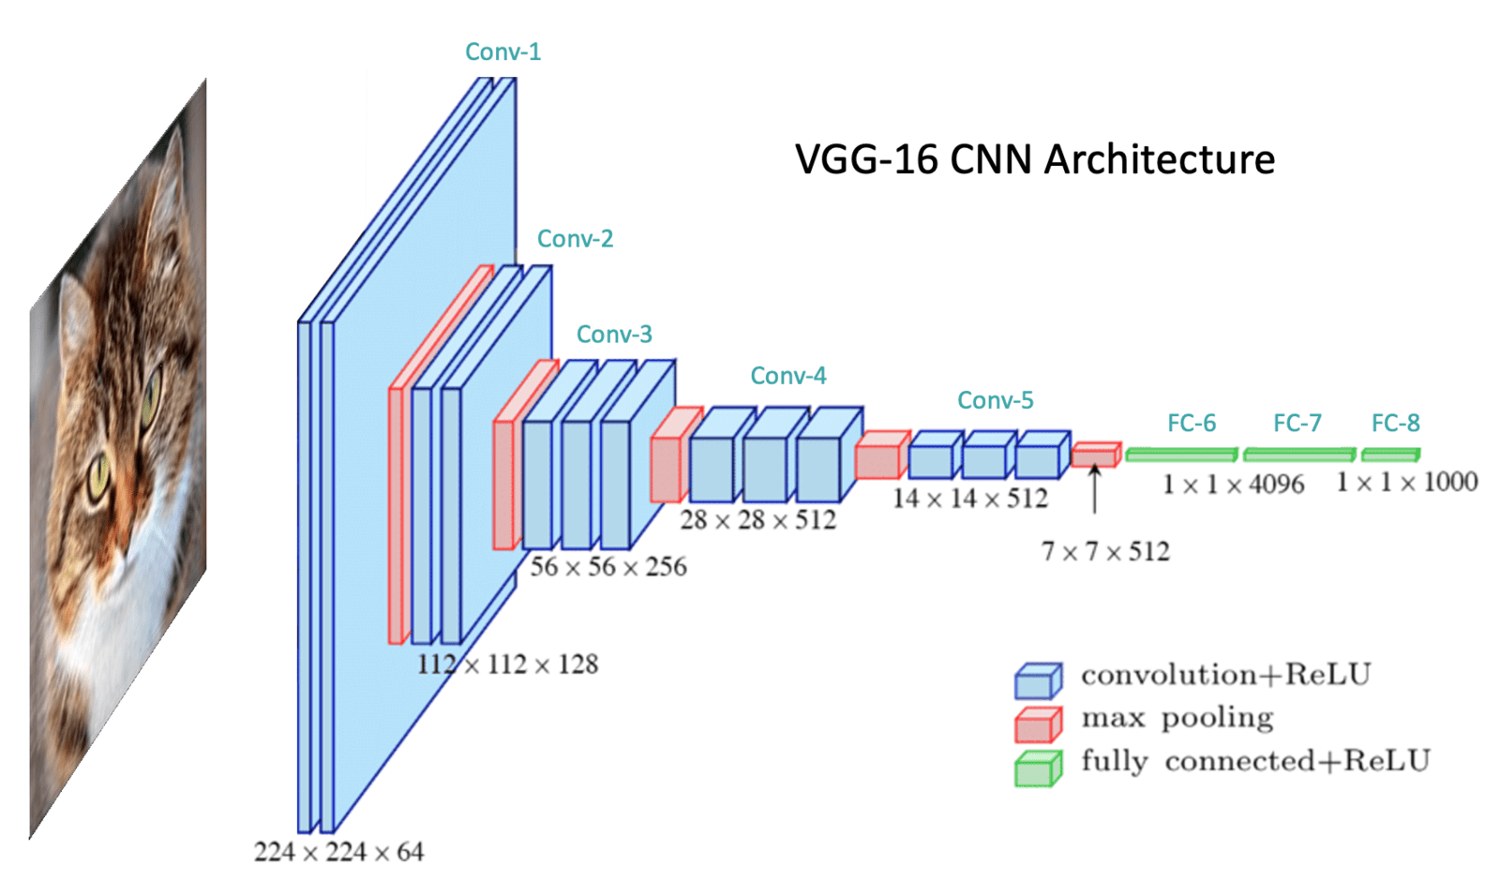
Convolutional Neural Network (CNN)
Why CNN =>
Excellent for computer vision!
Used for EEG [Saeidi et al. (2021)]
dEEGtal has explored these already
Easy to train
Relatively easy to XAI
Alternatives?
RNN / LSTM => for temporal signals
=> use electrode channel input instead of spectrogram!
https://learnopencv.com/tag/convolutional-neural-network-diagram/

Slide 24
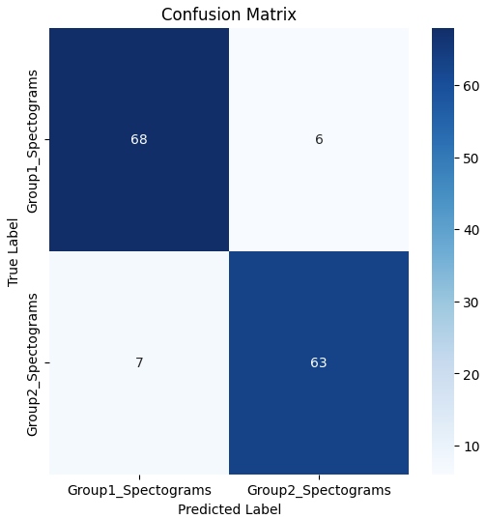
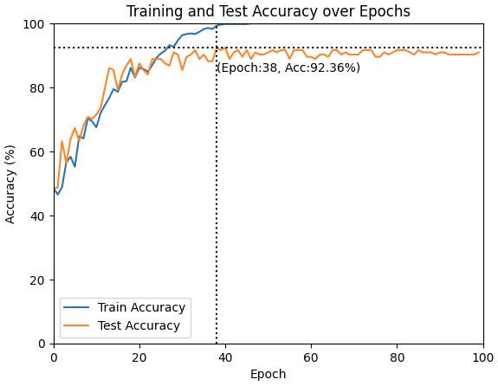
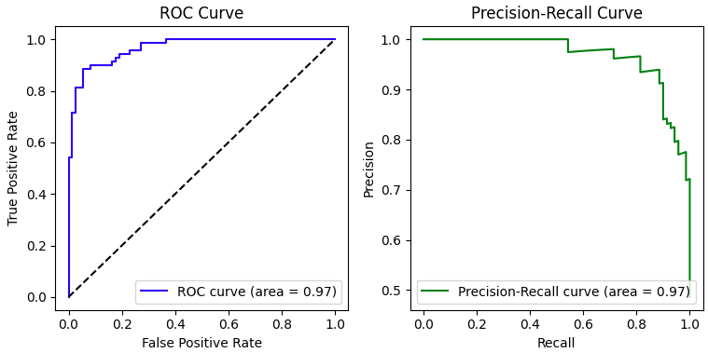
CNN – How did it do?
CNN Architecture:
Input (128x128)
2x Convolution
2x Pooling
2x Fully Connected
Output

Slide 25

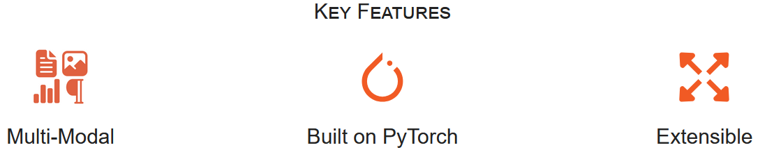
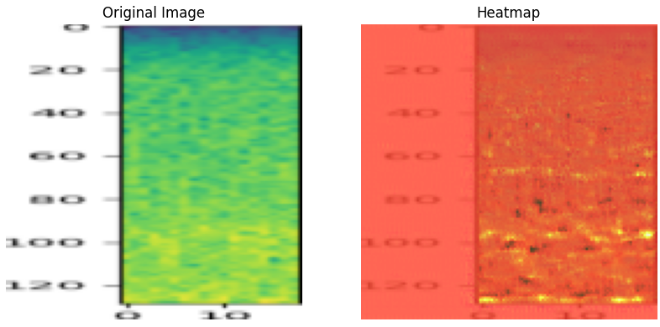
eXplainable AI
Integrated Gradients
120
100
80
60
40
20
0
Frequency [Hz]
Short events
0-40 Hz
0
10
Time [S]

Slide 26
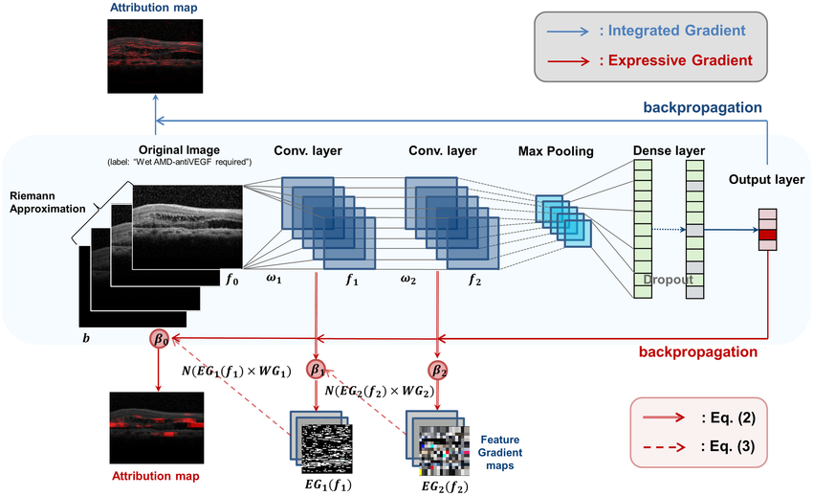
Backpropagation through network

Slide 27
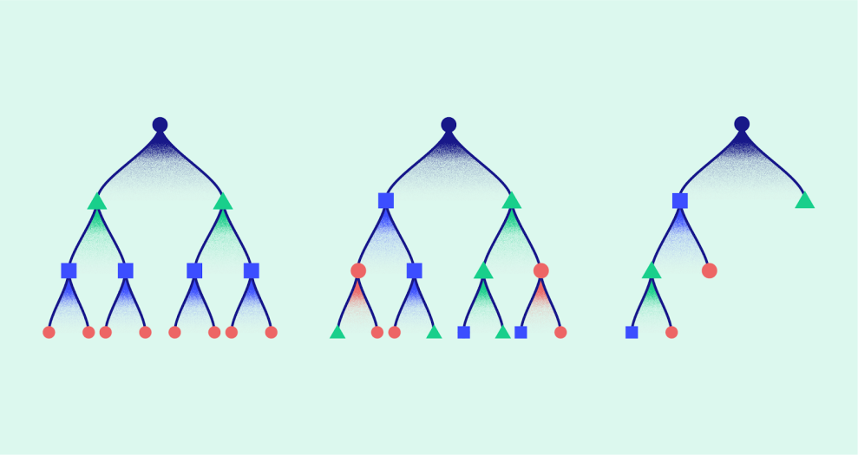

XGBoost
Gradient boosted decision tree
When in doubt => Use XGBoost!
+ Not sensitive to scaling
+ High performance
+ Easy feature importance tools
Works (in my experience) better with categorical/numerical features
https://analyticsindiamag.com/ai-mysteries/xgboost-internal-working-to-make-decision-trees-and-deduce-predictions/

Slide 28
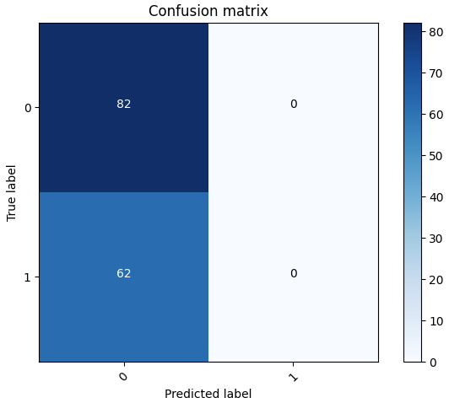
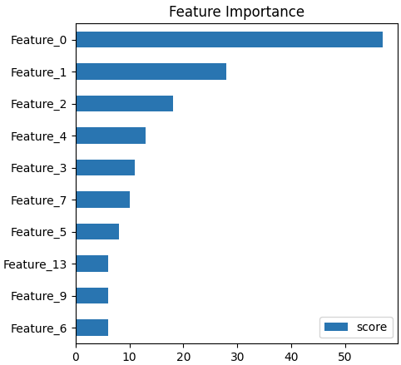
XGBoost - How did it do? (not good…)
Needs translation to back to freq + bin

Slide 29
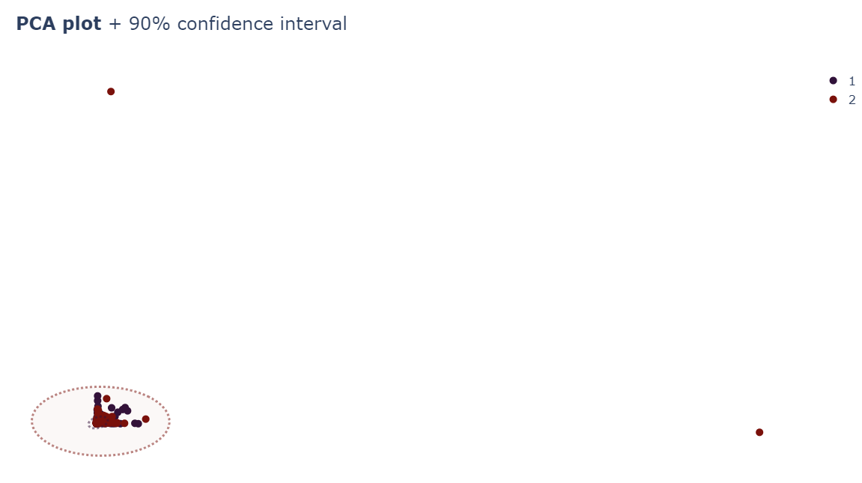
PCA
Lol…

Slide 30
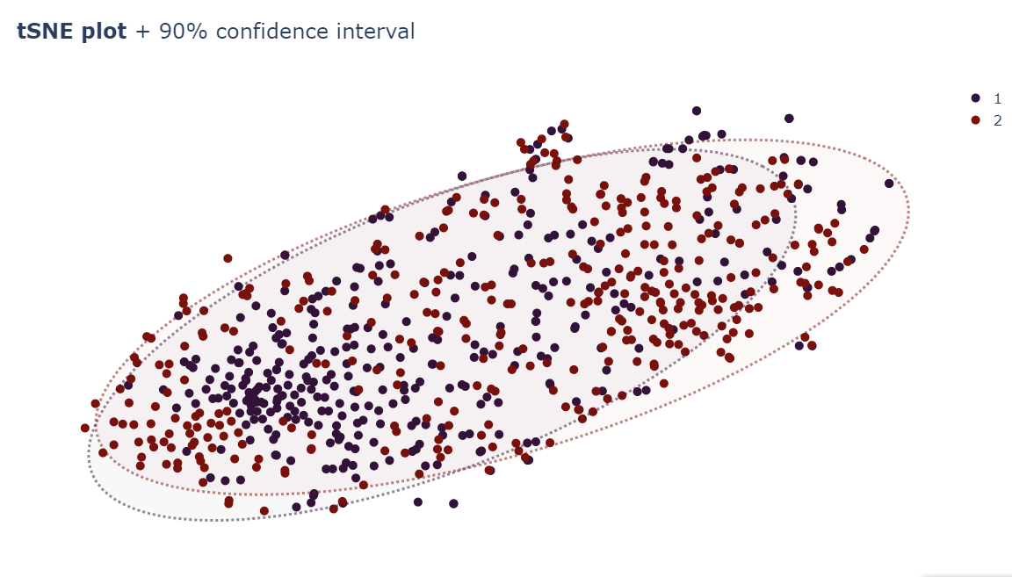
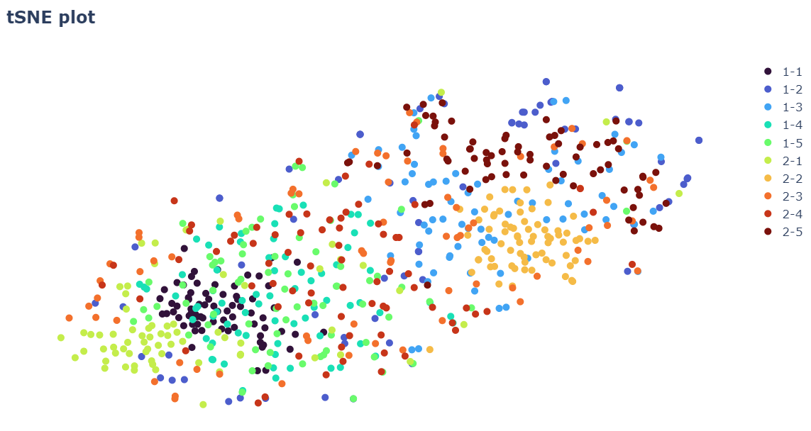
t-distributed Stochastic Neighbour Embedding (tSNE)
Not better

Slide 31
Hyperparameter tuning

Slide 32
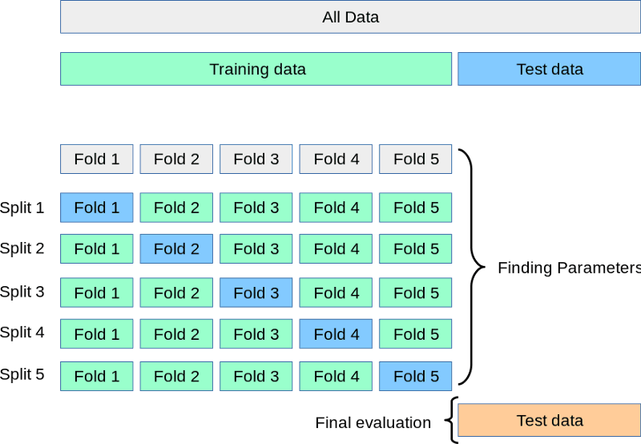
Stuff that affects performance
(Pre)Processing
Filtering
Window
length
Nr of windows
Overlap
ICA
Spectogram:
Resolution
Frequency Range
CNN:
Image transform
Architecture
Layers
Nodes
Training
Time (epochs)
Learning rate
Loss function
…
XGBoost:
Feature selection
Depth
N-times
No cross-validation done!
Data quality?
Ensure that recordings are comparable/representative!

Slide 33
Next steps
Ideas worth exploring:
Transfer learning from existing model => individualise model
Real time encoding, e.g. using LSTM
Data Quality model
Detects when input is optimal for epilepsy detection
…

Slide 34
Next steps
Medical Software != Academic Software
Main standard for medical devices software development:
IEC 62304 - Deals with the software lifecycle, i.e. almost everything about what software engineers do.
IEC 60601-1 - Applicable to embedded software in a hardware medical device,
IEC 82304-1 - Applicable to standalone software, i.e. Software as a Medical Device (SaMD),
IEC 81001-5-1 – Cybersecurity requirements
IEC 62366-1 - Man-machine interface ergonomics requirements.
ISO = International standards (mechanics)
IEC = International standards (electrical and electrical engineering)

Slide 35
Conclusion

Slide 36
Conclusion
Data Info crucial for Model Design ⬄ Model Design crucial for data choice
CNN lend themselves good for images
Much room for improvement
Good Explainability requires more than heatmaps

